Slide 1
Function Decomposition
Recognize driver’s face → Detector
Track face movement → Tracker

Slide 2
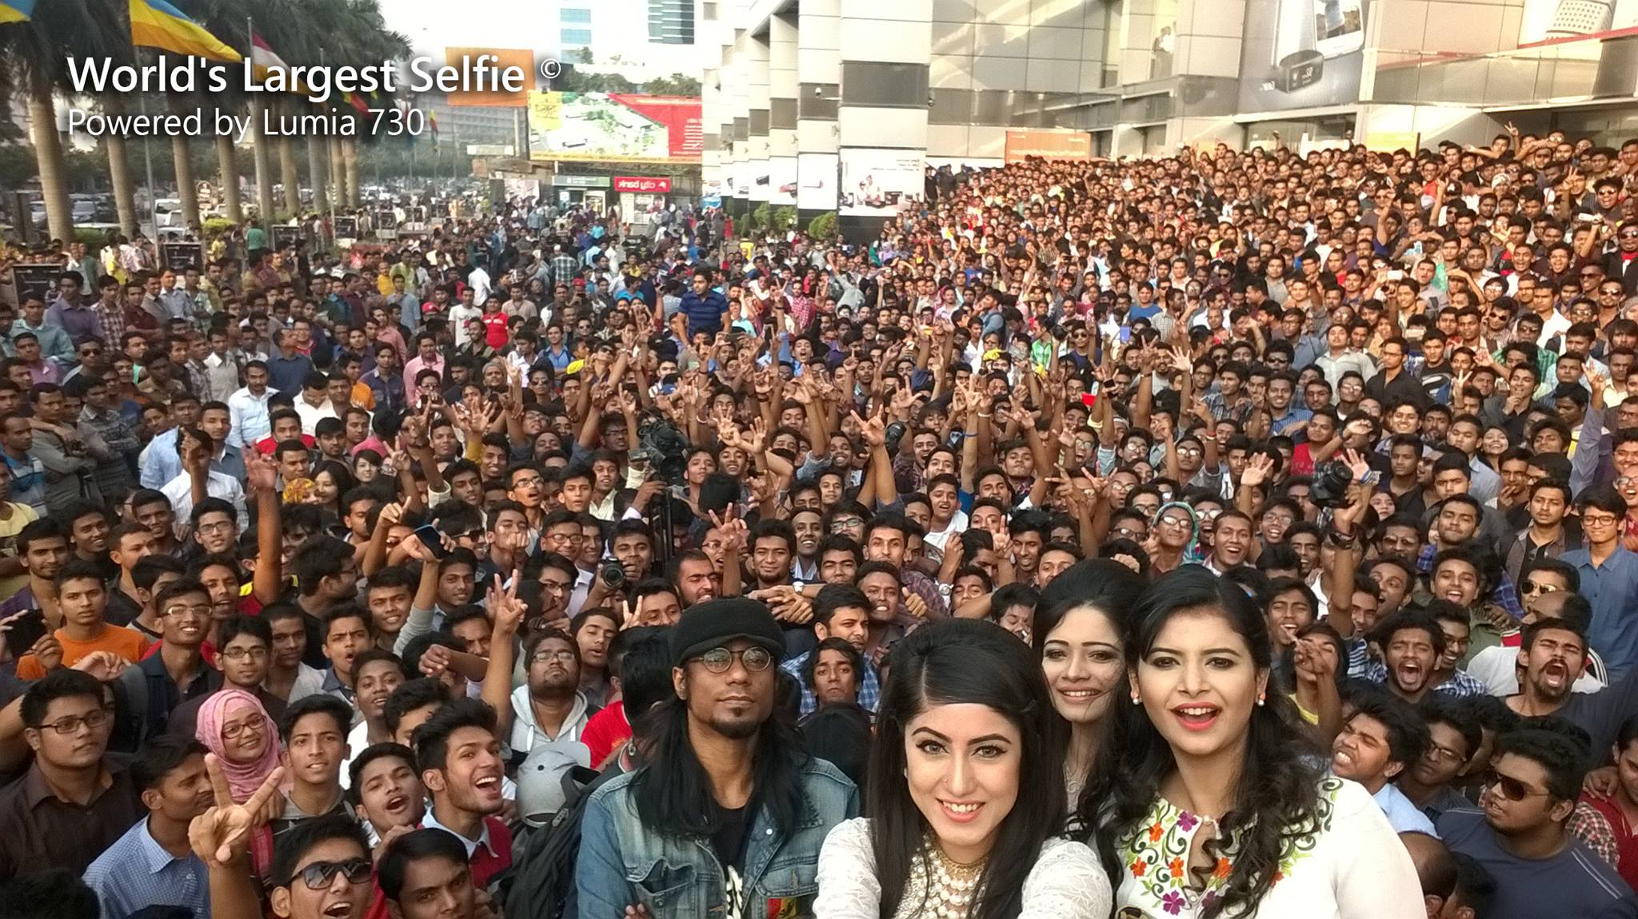
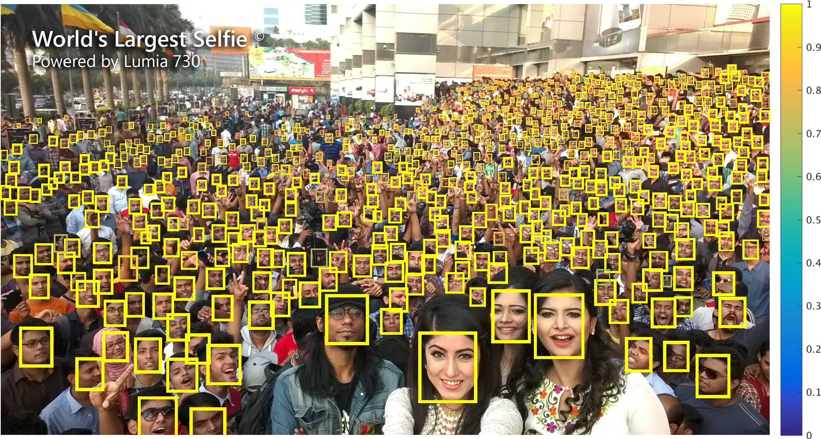
Detector
A function that detect the presence of a particular object in a given picture(frame).
→
detector
Source:https://github.com/peiyunh/tiny

Slide 3
Tracker
A function that locate a particular object based on its former position.

Slide 4
Concepts
Kernelized Correlation Filters(1 Detector + n tracker)
Pure Recognition(n Detector + no tracker)
Facial Tracking[请给他一个好听的名字！](n Detector + n tracker)

Slide 5
Decision-matrix Method
 | KCF | Pure Recognition | Facial Tracking
Speed | S
Precision | S
Recall | S
Portability | S
High Robustness | S
Stability | S
+ | 0
- | 0
score | 0

